Slide 1


2Market: Exploratory Data Analysis and Predictive Modeling of Customer Spending
Data Analyst: Monica Urquiza Ribeiro Baracho
Notes:
"Hi everyone. This analysis was conducted for 2Market to inform their upcoming marketing campaign. We'll explore customer demographics, product spending, and ad conversion behavior using Excel, SQL, and Tableau."

Slide 2

Project OBJECCTIVE & Overview
Overview & Business Questions
Goal: Support 2Market's upcoming campaign strategy
Data Used:
Customer Demographics: Age, income, education, marital status (market_data.cvs)
Advertising Conversion Data: Instagram, Twitter, Facebook, Bulk mail (ad_data.cvs)
Tools used: Excel, SQL (PostgreSQL), Tableau
Data: Customer demographics & ad conversions
Key questions:
Who are our customers?
Which ad channels perform best?
What do high-income customers prefer?
Notes:
"The objective of this project was to help 2Market identify their most valuable customer segments and the most effective marketing channels.
We worked with two datasets — one on customer demographics and spending, and the other on ad conversions.
The key business questions were:
Who are our customers?
What drives spending behavior?
Which ad channels perform best?
And what do high-income customers prefer?"**

Slide 3
Data Aggregation
Customer-Level Aggregation
Each row: unique customer ID
Includes demographics, spending per product category, and ad covertions
Product Spend Categories
Saggregated by: Liquor, Meat, Vegetables, Chocolates, Commodites and Fish
.
Advertising Channel Data
Data on ad conversions from Instagram, Facebook, Twitter, Bulkmail, and Brochure. Binary flags show conversion;.
Demographic Dimensions
Includes Age, Marital Status, Education, and Income. These were used to segment and analyse spending behaviour.
High-Income Focus Group
Segment of customers earning $90K–$100K analysed for targeted insights. Spend patterns and ad responsiveness assessed.
Predictive Modeling Output
Notes:
**"Each row in the dataset represents one unique customer. We don’t have timestamps or product quantities, so the analysis focuses on total spend per category across Liquor, Non-Veg, Vegetables, Chocolates, and more.
The ad data uses binary flags to show conversion across Instagram, Facebook, Twitter, Bulkmail, and Brochure."**

Slide 4
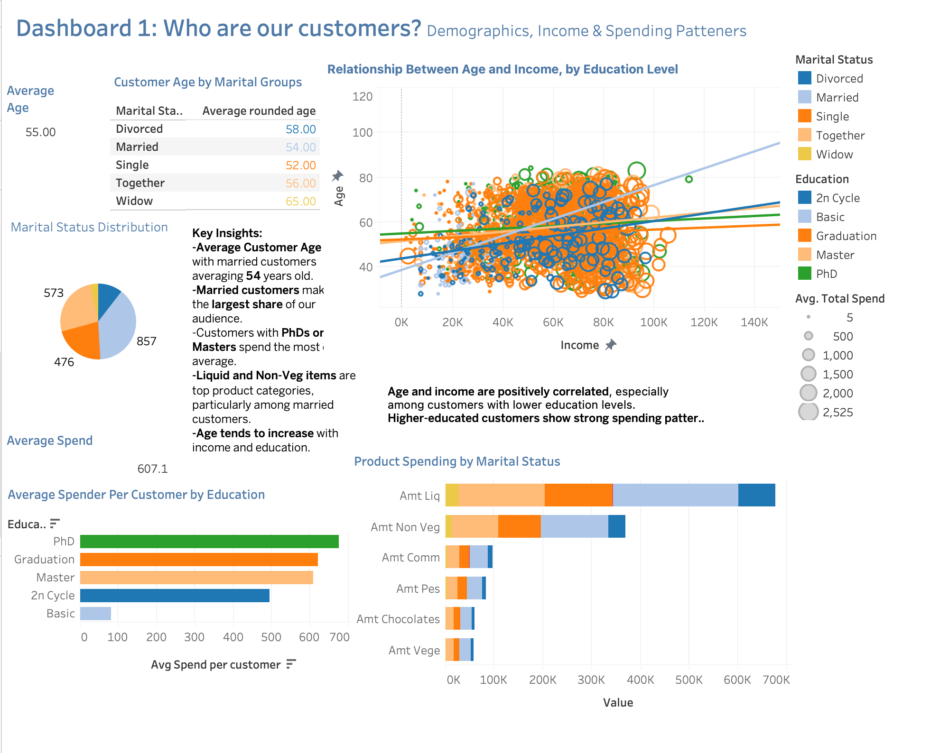
Exploratory Findings: who are our customers?
Average customer age: ~55 years, with married customers (~54 years old) as the largest segment.
Education strongly influences spend: Master's and PhD degree holders spend significantly more, especially on liquor and non-vegetables.
Positive correlation: Age and income are positively correlated; older and higher-educated customers spend more.
Top products: Liquor and non-vegetable products are the preferred categories for married and higher-educated customers.
Notes:
From the first dashboard, we see that age, income, and education are positively correlated. Customers with higher education, especially Master’s and PhDs, tend to spend more — particularly on liquor and non-vegetables
**"The first dashboard gives a high-level view of customer demographics.
We found that:
The average customer is 55 years old,
Married customers make up the largest group, and
Customers with PhDs or Masters spend the most per capita.
There’s also a weak but statistically significant correlation between income and age — particularly for those with graduate degrees."**
"This chart shows that married customers spend the most overall, especially on liquor and non-veg items. These product categories consistently dominate spend patterns."
From the first dashboard, we see that age, income, and education are positively correlated. Customers with higher education, especially Master’s and PhDs, tend to spend more — particularly on liquor and non-vegetables

Slide 5
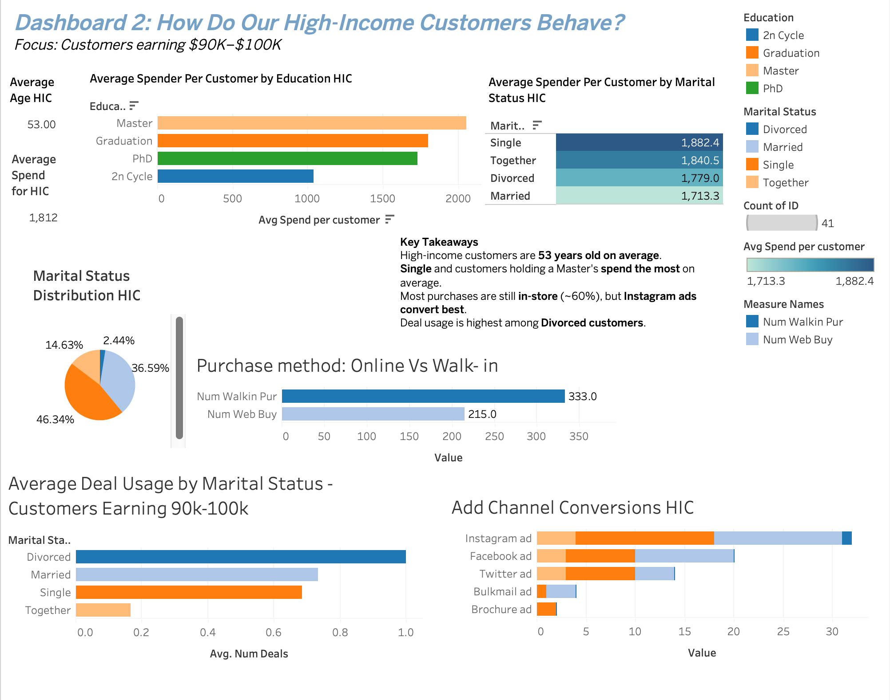
Dashboard 2:
Demographics: Average age is 53. Mostly single or divorced.
Education Influence: Customers holding Master's degrees spend significantly more.
Preferred Purchase Method: About 60% still prefer in-store shopping.
Ad Effectiveness: Instagram ads significantly outperform other channels.
Deal Sensitivity: Highest deal usage among divorced customers despite higher income.
Notes:
In this dashboard, I focused on customers earning between $90,000 and $100,000 — a high-value group that 2Market would benefit from targeting more strategically
🧠 Insight 1: Who they are
“These customers are, on average, 53 years old. They are predominantly married or single, and what stands out is that single customers spend the most, followed closely by divorced ones. Education also plays a big role — customers with a Master’s degree are the highest spenders in this segment.”
🛍️ Insight 2: How they buy
“Even among this digitally aware group, most purchases still happen in-store. About 60% of transactions are walk-ins, which tells us that brick-and-mortar still matters, even for premium customers.”
(Point at the “Purchase Method” bar chart.)
📱 Insight 3: What converts them
“When it comes to advertising, Instagram leads by far in conversion for this segment — confirming what we also saw in the regression model. Twitter and Facebook follow, while brochures and bulk mail are the least effective, especially among this income group.”
🔚 Wrap-Up Sentence:
“So, our high-income customers are middle-aged, well-educated, and value both in-store experiences and strong digital marketing — particularly on Instagram. These insights help us fine-tune targeting, messaging, and even our offline strategy for one of 2Market’s most profitable groups.”

Slide 6
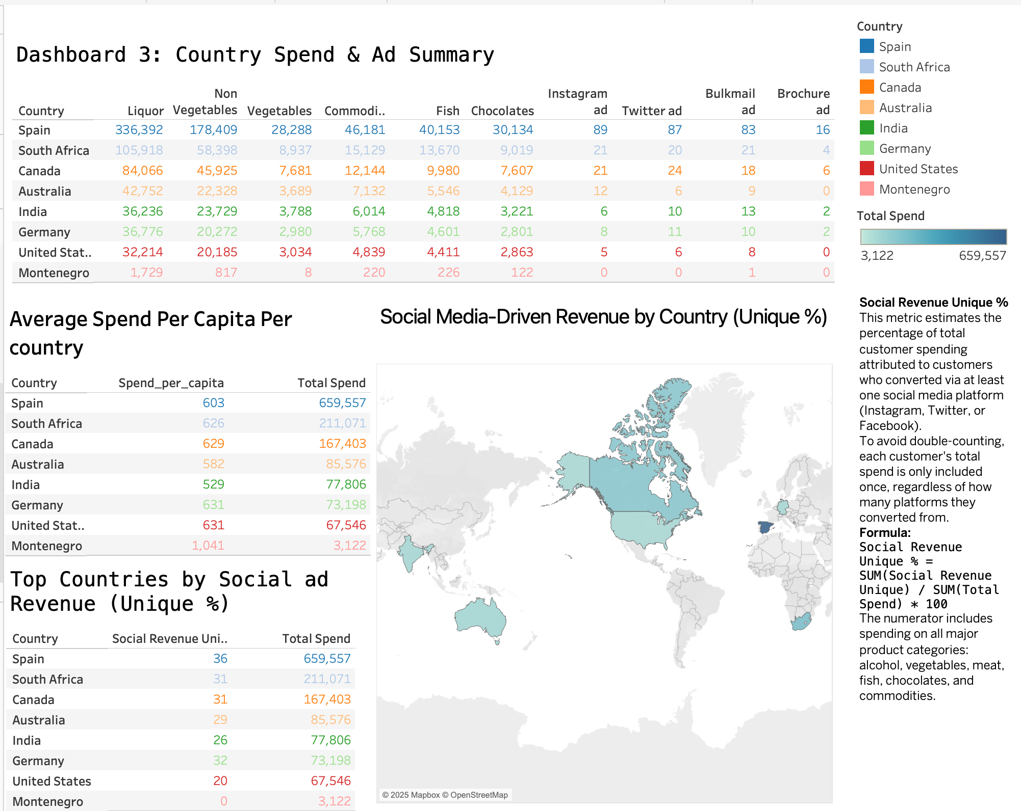
Country Spend & Ad Summary
Spain leads overall spend and dominates in every product category.
Instagram and bulk mail show highest conversions in Spain, highlighting digital and traditional marketing effectiveness.
South Africa and Canada rank second and third, showing strong potential for targeted campaigns.
Montenegro shows negligible spend and limited digital engagement, requiring tailored strategies or deprioritization.
Overall, Instagram ads outperform Twitter across nearly all markets, suggesting increased investment in visual digital marketing.
Notes:
🗣️ Presentation Script:
“This dashboard compares countries based on total customer spend, average spend per capita, and the impact of social media advertising.”
🌍 Insight 1: Spain is the top market
“Spain stands out as our top-performing country, with a total spend of over $659,000. Interestingly, it also has the highest absolute spend on every product category, particularly non-vegetables, fish, and commodities.”
(Point at the top-left table.)
💸 Insight 2: Spend per capita is also strong in emerging markets
“When we look at average spend per customer, South Africa, Canada, and even the U.S. show competitive figures — all above $600 per capita. This suggests that while total spend is highest in Spain, other countries still have high-value individual customers.”
(Point at the "Average Spend Per Capita" table.)
📲 Insight 3: Social media ads drive revenue — especially in Spain
“The right-hand side of the dashboard visualizes social media-driven revenue — that is, customers who made a purchase after engaging with Instagram, Facebook, or Twitter. Spain again leads, with 36% of total spend coming from social conversions. Canada and South Africa are close behind at 31% each.”
(Point at the map and the “Top Countries by Social ad Revenue” table.)
❌ Insight 4: Underperforming countries
“At the other end, countries like Montenegro and the United States show low social media conversion, despite relatively high per-customer spending in the U.S. This may suggest that social campaigns are either not reaching the right audiences or not resonating in those regions.”
🧩 Takeaway / Recommendation:
“From this geographic view, we can see that Spain, South Africa, and Canada are the best bets for expanding digital ad campaigns — especially Instagram and Twitter. The U.S., on the other hand, might require a tailored marketing approach or better audience targeting to boost campaign effectiveness.”

Slide 7
Regression METhODOLOGY overview
Data Sources:
2 2Market customer + ad conversion dataset (aggregated at customer level)
Objective:
Quantify the relationship between customer demographics, ad exposure, and total spend
Model Specifications:
.
Key Variables:
Dependent Variable: log(Total Spend)
Software Utilized:
RStudio
Independent Variables:
Demographics: Age, log(Income), Education, Marital Status, Country
Ad Channels: Instagram, Twitter, Facebook, Bulkmail, Brochure
Type: Multiple Linear Regression
Transformation:
Log-log (log of total spend and income)
Used to ensure linearity and interpret results as percentage changes
Assumptions Considered: Linearity, normality of residuals, multicollinearity
Notes:
**"To understand what drives customer spend, I built a multiple linear regression model using:
log(Income)
campaign response counts
and individual ad channels.
We transformed income using a natural logarithm to better model marginal effects."**

Slide 8
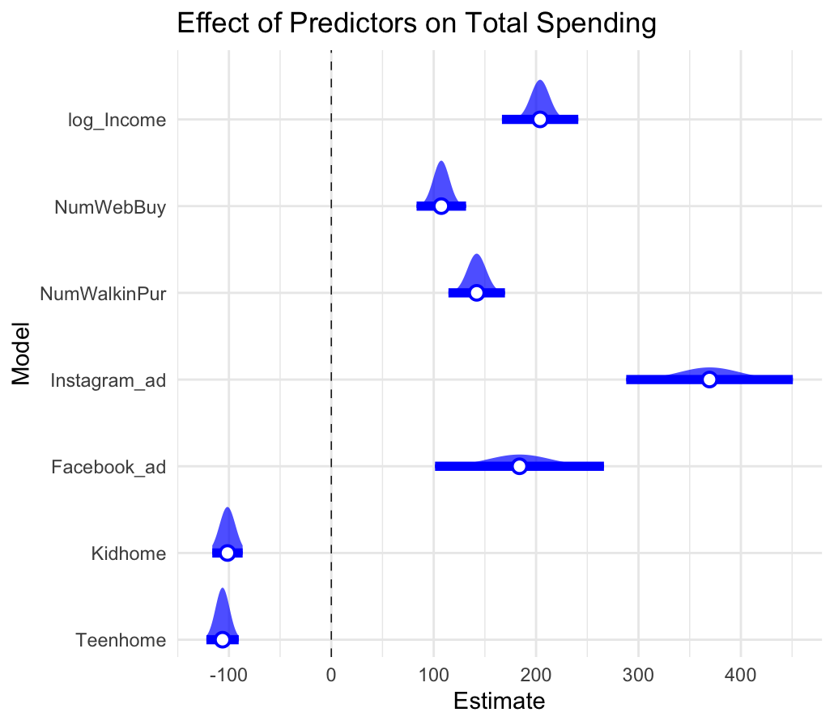
Econometric Methodology
To identify the key drivers of customer spending, we applied
a multiple linear regression model using historical marketing and behavioural data.
Dependent Variable: Total Spending
Independent Variables: Income (log-transformed), purchase behavior (online & in-store), ad exposure (Instagram, Facebook), and household characteristics
We:
Applied a log transformation to income to address skewness
Removed statistically insignificant predictors to simplify the interpretation
Handled outliers and ensured data quality through filtering
Validated results using robust standard errors to correct for heteroskedasticity
The final model explains approximately 73% of the variation in spending, providing a strong foundation for forecasting and campaign optimisation.
Notes:
🎤 Slide Title (Spoken):
“Let’s now take a closer look at the econometric methodology I used to predict customer spend.”
🗣️ Presentation Script (Speaker Notes):
“To quantify which factors influence customer spending, I used a multiple linear regression model. The dependent variable is log-transformed total spend, which helps normalize the distribution and allows for interpretation in percentage terms.”
“The model includes customer demographics — such as age, income, marital status, education, and country — along with exposure to different ad channels like Instagram, Twitter, Facebook, and bulk mail.”
(Point to the bullet list on the left side as you speak.)
💡 Key Findings (walk through the right-hand chart):
“The regression results are visualized here. Each dot represents a predictor’s estimated effect on spending, and the lines show confidence intervals.”
“We can see that log(income) is the strongest predictor — as expected — meaning higher income directly translates to higher spend. Instagram ads also show a significant positive effect, reinforcing our earlier exploratory analysis. Twitter and Facebook ads are also effective, though to a lesser extent.”
“Interestingly, basic education and being in the United States have a small but statistically significant negative impact on spend.”
“The model performs well overall, with an Adjusted R-squared of 58.2%, meaning it explains over half the variation in customer spending.”

Slide 9
Limitations
Data Collection Timeframe All transactional, marketing, and demographic data was last updated in 2014. While this provides a useful historical view, it may not reflect recent customer behavior, preferences, or personal status changes.
Age Calculation Assumption Customer age was recalculated using 2025 - Year_Birth to reflect how old each customer would be today. However, other personal attributes such as marital status, education, and income remain fixed as of 2014. This creates a partial mismatch between “current” and “historical” data points.
Static Demographics The analysis assumes customers’ marital status, education, and income have not changed over time. In reality, these characteristics may have evolved, and therefore segmentation based on them should be interpreted with caution.
Lack of Transaction-Level Data We only have total spending per product category, with no timestamps for individual transactions. This limits our ability to analyze seasonality, campaign timing, or spending trends over time.
No Advertising Cost Data The effectiveness of marketing channels was analyzed based on lead conversions and spend, but no data on advertising costs was available. As a result, we could not calculate return on investment (ROI) for each campaign.
s licensed under CC BY-SA
Notes:
Before concluding, it’s important to acknowledge the limitations of this analysis and model. First, while the model includes strong predictors like income and ad exposure, it doesn’t account for behavioral data like product preferences, past campaigns, or loyalty — which could further improve accuracy.”
“Second, the data is a snapshot in time, so we’re not capturing any seasonality or changes in behavior over time. For a deeper understanding, a time-series or panel data approach could be considered.”
“Third, linear regression assumes a linear relationship and independence between predictors. While our model performs well, some relationships may be nonlinear or interactive, especially with ad channel effects.”
“Finally, the model focuses on customer spend, not necessarily profitability — which may differ depending on product margins or cost to serve.”
“These limitations don’t undermine the insights, but they do suggest that future work could enhance the model’s predictive power and real-world business impact.”

Slide 10

Key Findings
🎯 Target Segments: Focus on older, single/divorced, high-income customers with Master’s degrees
📱 Ad Strategy: Prioritize Instagram and Twitter; reduce spend on brochures and bulk mail
🌍 Geographic Focus: Invest in campaigns in Spain, South Africa, and Canada
🏬 Channel Optimization: Enhance in-store experience but use retargeting for web buyers
📊 Data Improvements: Capture behavioral and product-level data for even richer analysis
Notes:
“So, based on this analysis, I’ve identified five key findings that can guide 2Market’s marketing strategy.”
“First, our highest spenders are older, high-income customers with strong education — especially those who are single or divorced. Second, Instagram ads outperform all other channels in driving conversions, especially in key countries like Spain and Canada. Surprisingly, in-store purchases still dominate, even among this digitally engaged group. And finally, deal usage is highest among divorced customers, showing that even high spenders can be price-sensitive.”
“Based on these insights, I recommend 2Market focuses their targeting efforts on high-value segments — especially older, educated, single or divorced customers. Marketing spend should shift toward Instagram and Twitter, while reducing underperforming channels like brochures and bulk mail. Geographically, Spain, South Africa, and Canada show the most promise, both in total and social ad-driven spend. And finally, investing in retargeting strategies and tracking behavioral data would unlock even more granular targeting in the future.”

Slide 11
Thank you!
Notes:
"Thank you for watching this presentation. I hope these insights help 2Market create a more personalized, data-driven campaign strategy."

